Slide 1

-
Database systems
SCSE

Slide 2
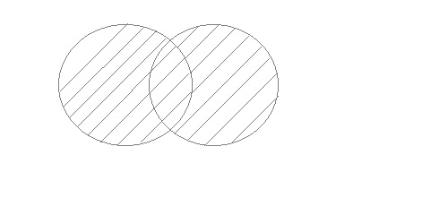
Union
UNION is used to combine the results of two or more SELECT statements.
However it will eliminate duplicate rows from its result set.
In case of union, number of columns and data type must be same in both the tables, on which UNION operation is being applied.

Slide 3
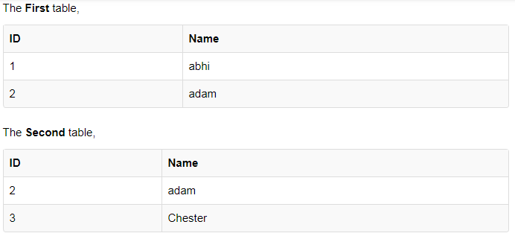
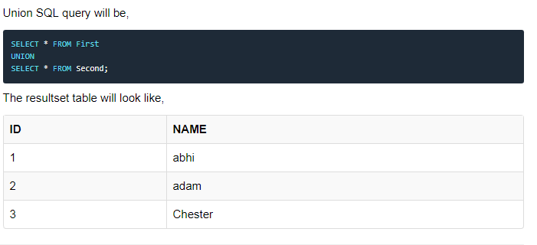
Example of UNION

Slide 4
Syntax
SELECT column_name(s) FROM table1
UNION
SELECT column_name(s) FROM table2;

Slide 5
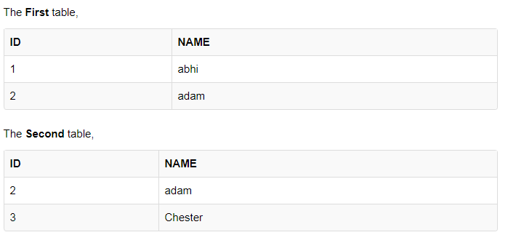
UNION ALL
This operation is similar to Union. But it also shows the duplicate rows.

Slide 6
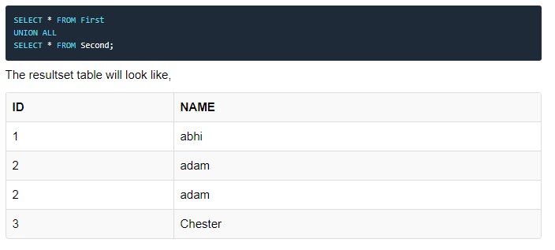

Slide 7
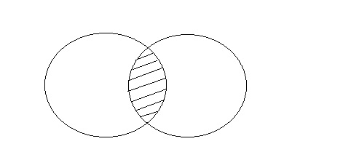
INTERSECT
Intersect operation is used to combine two SELECT statements, but it only retuns the records which are common from both SELECT statements.
In case of Intersect the number of columns and datatype must be same.

Slide 8
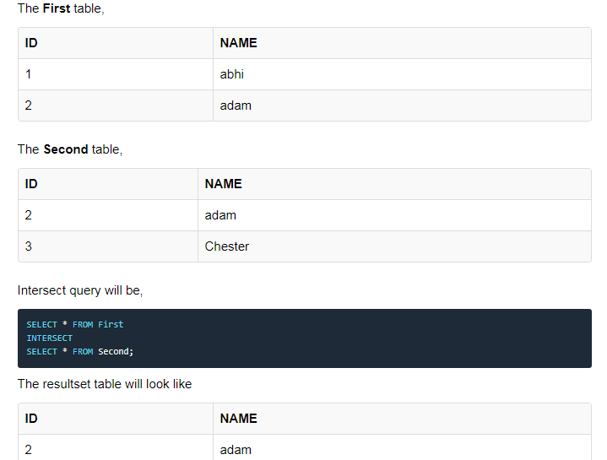
Example of Intersect

Slide 9
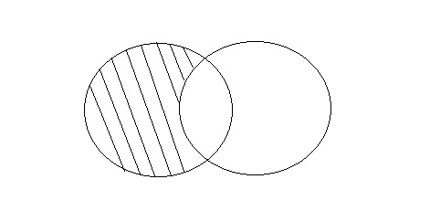
MINUS
The Minus operation combines results of two SELECT statements and return only those in the final result, which belongs to the first set of the result.

Slide 10
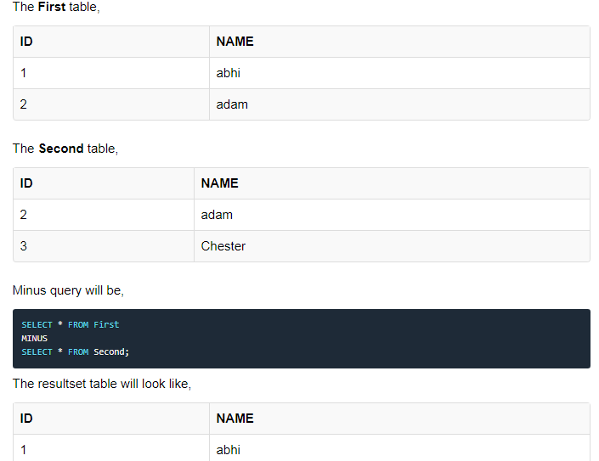
Example of Minus

